Slide 1
Project Based Learning -II
Team Details:
Anmol Verma (2110993762)
Jatin Verma(2110993803)
Kangna Galhotra(2110993804)
Faculty Coordinator: Mr. Deepak Kumar
Mr. Sahil Garg
:
Chitkara University Institute of Engineering and Technology,
Chitkara University, Punjab

Slide 2
Table of Contents
Introduction
Problem Statement
Technical Details
Key Features
Project Highlights
Conclusion
References/Links used

Slide 3
Introduction
A skin lesion classification project involves the development and implementation of deep learning models to accurately categorize and diagnose various skin lesions based on medical images. These projects aim to leverage artificial intelligence to assist dermatologists and healthcare professionals in the early detection and classification of skin conditions, including benign and malignant lesions. The goal is to improve diagnostic accuracy, enable timely intervention, and enhance patient care in the field of dermatology and skin health.

Slide 4
Problem Statement
Skin cancer is a significant public health concern worldwide, and early and accurate diagnosis is critical for effective treatment and improved patient outcomes. Dermatologists face challenges in consistently and rapidly classifying a wide range of skin lesions, as it often relies on subjective visual examination. Automated skin lesion classification systems, powered by deep learning and computer vision, have shown great promise in enhancing diagnostic accuracy. However, developing a robust and reliable skin lesion classification model that can be seamlessly integrated into clinical practice remains a complex and evolving challenge.

Slide 5
WHY SKIN LESION CLASSIFICATION?
The Importance of Skin Lesion Classification
Early Detection
Accurate classification of skin lesions can help with early detection and treatment of skin cancer.
Treatment Planning
Classifying skin lesions can help dermatologists decide on the best treatment plan for the patient.
Improved Patient Outcomes
An accurate diagnosis and classification of skin lesions can improve patient outcomes and quality of life.

Slide 6
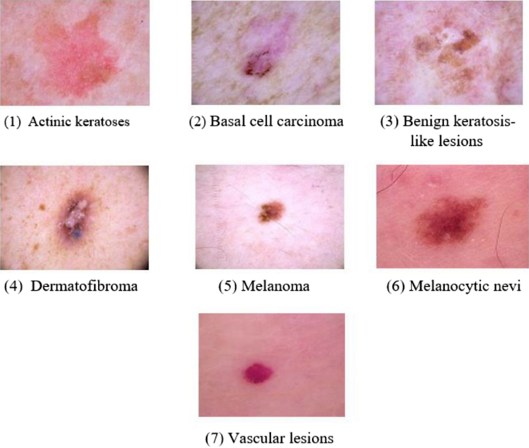
TYPES OF SKIN LESIONS:

Slide 7
Technical Details
Libraries used:
1. NumPy: NumPy is a fundamental Python library for numerical computations, providing support for arrays and matrices, along with a wide range of mathematical functions.
2. Pandas: Pandas is a Python library that offers data structures like DataFrames and Series, making data manipulation and analysis easier, especially for tabular data.
3. Scikit-Learn (Sklearn): Scikit-Learn is a machine learning library for Python that provides a wide array of tools and algorithms for tasks such as classification, regression, clustering, and more.
4. TensorFlow: TensorFlow is an open-source deep learning framework developed by Google, widely used for building and training neural networks for various machine learning and AI applications.
5. Keras: Keras is an open-source neural network library that serves as a high-level API for building and training deep learning models. It can run on top of TensorFlow and other deep learning frameworks.
Model Used:
1. VGG16 Pretrained Model: VGG16 is a pre-trained convolutional neural network model known for its simplicity and effectiveness in image classification tasks, with 16 weight layers.
2. InceptionV3 Pretrained Model: InceptionV3 is a pre-trained deep convolutional neural network known for its complex architecture, including inception modules, and its strong performance in image recognition and transfer learning tasks.

Slide 8
Key Features
Key features to solve the skin lesion classification problem:
1. Quality Data: High-quality, diverse dataset of skin lesion images.
2. Transfer Learning: Leveraging pre-trained models for feature extraction.
3. Optimized Architecture: Designing and fine-tuning neural network architecture.
4. Proper Evaluation: Selecting relevant evaluation metrics for performance assessment.
5. Interpretability: Methods to explain model decisions.
6. Ethical Considerations: Addressing privacy, bias, and ethical concerns.
7. User Interface: Intuitive interface for user interaction.
8. Validation: Clinical validation with experts for real-world applicability.
9. Scalability: Handling a large volume of images efficiently.
10. Continuous Improvement: Regular model updates and adaptation to new data.

Slide 9
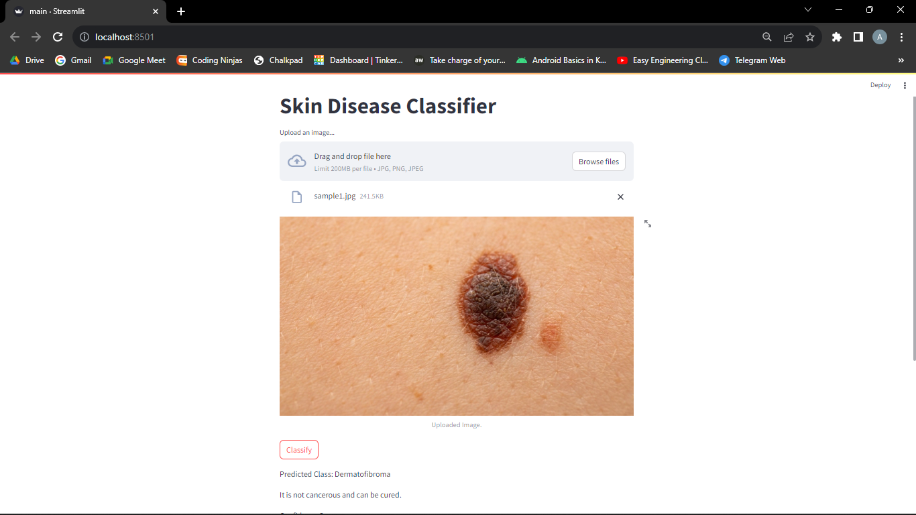
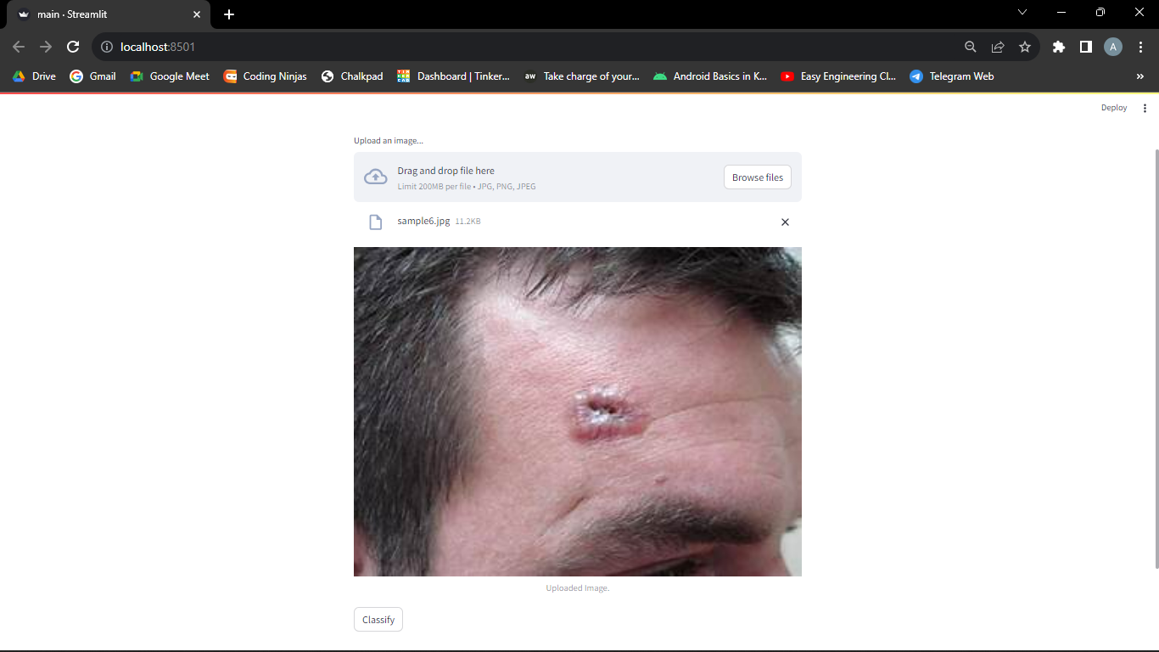
Project Highlights

Slide 10
Conclusion
In summary, our skin lesion classification project has developed a highly accurate and user-friendly AI model for classifying skin lesions. With a focus on ethics and scalability, the system shows promise for early diagnosis and improving patient care. Collaboration with medical experts is key for real-world validation and ongoing enhancement. This project exemplifies the positive impact of AI in healthcare

Slide 11
References/Links used
Wikipedia
Dataset from :The HAM1000
Chatgpt

Slide 12


